Slide 1
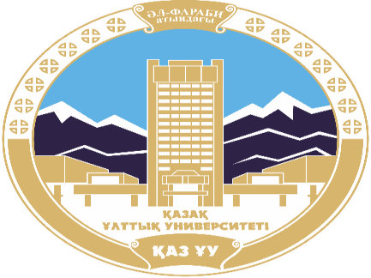
AL-FARABI KAZAKH NATIONAL UNIVERSITY
Department of political science and political technologies
Political systems and regimes
Abzhapparova A.A.
Senior lecturer

Slide 2
Political systems and regimes
Lecture 14
Political system of Kazakhstan and practice of its transformation. Mechanisms of adaptation of the political system of Kazakhstan

Slide 3
Lecture plan:
1. Political system of modern Kazakhstan. Development of political parties in modern Kazakhstan
2. Development of civil society and its political institutions.
3. Information policy of the Republic of Kazakhstan, media development

Slide 4
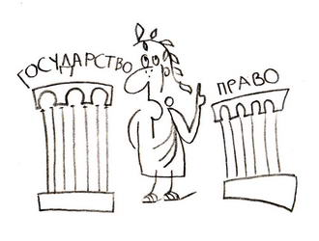
1. Political system of modern Kazakhstan. Development of political parties in modern Kazakhstan
The most important tasks of political reform in the Republic of Kazakhstan are the creation of a state governed by the rule of law and a civil society, the highest value of which is human rights and freedoms.

Slide 5
Stages of political reforms in Kazakhstan
Political reforms in the Republic of Kazakhstan over the years of independence include: multiple stages:
1991-1993 years;
1993-1995 years;1995-1999;
1999-2001 years;
2001-2017.

Slide 6
1991-1993
1993-1995
The first two stages reflect the evolution of the constitutional system of the Republic of Kazakhstan, the form of government from parliamentary to political. semi-presidential and the presidential republic, the formation of the statehood of the new Kazakhstan in the post-Soviet period.

Slide 7
1995-1999
The third stage was characterized by the consolidation of the foundations of the constitutional system, defined in the current Constitution, and the approval of a set of constitutional laws.

Slide 8
1999-2001
2001-2019
The fourth and current stage of political reforms reflects the actualization of further changes in the political sphere. Thus, in his annual address to the people of Kazakhstan in October 2000, President N. Nazarbayev noted that the pace of political reform is lagging behind the scale of economic transformation.

Slide 9
The main directions of political reforms focused on the development of democratization were presented in the annual Addresses of the Head of State to the people of Kazakhstan in 1998 and 2000. The agenda for democratizing the political system of Kazakhstan's society included:
- strengthening the independence of the judicial system, legal reform;
- extension powers of representative authorities;
- expansion of electivity and improvement of electoral legislation;
- strengthening civil society institutions.

Slide 10
The process of transformation of the political system of Kazakhstan in its development has passed the following stages::
1990-1993 - liberal-democratic traditions were introduced into the public life of the republic;
1993-1995 - new Constitutions of the Republic of Kazakhstan have been adopted, a number of civil society institutions have been established, and the Assembly of People of Kazakhstan has been established;
1995-1998 - power was reallocated, a bicameral parliament was elected for the first time, which led to the beginning of political transformations;
1998-present - Further democratization of Kazakhstan is taking place in accordance with the traditions and principles of Western democracies.

Slide 11
The main directions of the political reform program were defined in the speeches of the Head of State in 2005-2006 and include the following provisions:
- electability akims;
- expansion of the Parliament's composition and powers;
- expanding the functions of local representative government;
- reform of the judicial system;
- large-scale fight against corruption.

Slide 12
Kazakhstan has achieved a certain level of modernization of the political system:
- the development of democratic institutions is consistent; free democratic elections are regularly held;
- the principle of separation of branches of government has been implemented;
- there is political pluralism and multiparty system;
- the foundations of an independent judicial system have been laid;
- there is no censorship;
- non-State mass media have been established and are functioning.

Slide 13
In as a result of consistent political reforms in Kazakhstan at the current stage, a type of political system has developed, which is characterized by the following features::
- in the state structure, the principle of dividing a single state power into legislative, executive and judicial branches has really been established;
- the transition to holding general elections of the Head of State and representative bodies has been completed;
- political diversity has been established by law, and the formation of a multiparty system has begun;
- non-governmental media outlets are actively operating;
- the process of creating non-governmental organizations continues;
- equal rights of all ethnic groups of the population are enshrined in law and implemented in practice;
- the base of the market economy has been formed.

Slide 14
In March 2017, President of Kazakhstan Nursultan Nazarbayev signed the law "On Amendments and additions to the Constitution of the Republic of Kazakhstan", which provides for the redistribution of powers between the branches of government.

Slide 15
Political parties of the Republic of Kazakhstan
The Constitution rk guarantees the rights of parties, movements, and associations, with the exception of those whose activities are aimed at " forcibly changing the constitutional order, violating the integrity of the republic, undermining State security, and inciting social, racial, national, religious, class, and clan discord." State interference in the affairs of political parties and public associations is not allowed.

Slide 16
According to the latest version of the Law of the Republic of Kazakhstan "On Political Parties", a political party must have at least 40,000 members.

Slide 17
Parties of the Republic of Kazakhstan in 2017:
1) Party "Нұр Otan»
2) Political party "Бірлік»
3) Democratic Party of Kazakhstan "Ақ zhol»
4) People's Democratic Patriotic Party "Ауыл»
5) Communist People's Party of Kazakhstan
6) National Social Democratic Party

Slide 18
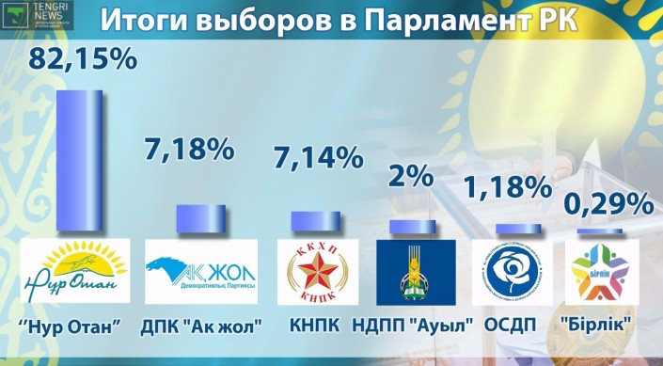
Results of the parliamentary elections
(January 2016)

Slide 19
2. Development of civil society and its political structures institutions
Civil society - this is a sphere self-displays free citizens and voluntarily formed organizations non-commercial targeted associations and organizations that are protected from direct interference and arbitrary regulation by government authorities and businesses, as well as other external factors.

Slide 20
Civil society – it is one of the guarantors of respect for human rights, a set of public relations outside the framework of government and commercial structures, but not outside the framework of the state as such. A developed civil society is the most important prerequisite for building a State governed by the rule of law and its equal partner.

Slide 21
Citizens of a democratic State enjoy the right to individual freedom, but at the same time they share the responsibility of building the future together with other State institutions.

Slide 22
Civil society goal
The purpose of civil society is to protect the interests of each member of society, represent their interests in the face of the authorities and society, public control over the activities of the authorities and the formation of the internal and foreign policy of this society.

Slide 23
A democratic civil society is inseparable from the rule of law, just as the rule of law is inseparable from civil society. Civil society is the reverse side of the rule of law, they do not exist without each other. The formation of a civil society is a necessary condition for the transition to a legal state, just as the rule of law is a factor contributing to the transformation of society into a civil whole.

Slide 24
Formation of civil society in the Republic of Kazakhstan
Fundamental reforms in the economic, social and political spheres that began in the late 1980s and early 1990s stimulated the creation of public associations to protect the rights and interests of various social groups.

Slide 25
Independent trade unions representing the interests of workers in the non-State sector of the economy were among the first to appear in Kazakhstan.
Active institutionalized mass media, public and religious associations, and political parties.
The most a vivid manifestation of civic consciousness was the public movement "Nevada-Semipalatinsk", which set itself the task of closing nuclear landfills.

Slide 26
2001 - Law of the Republic of Kazakhstan "On Non-Profit Organizations",
2002 - The concept of state support for non-governmental organizations.
July 25, 2006 - decree "On the concept of civil society development in the Republic of Kazakhstan for 2006-2011»

Slide 27
Aboutsnovny the direction of development of civil society, according to this concept and its plan, was support and development NGOs (non-governmental organizations) with the help of social orders - a form of implementation of social programs, projects, as well as individual activities aimed at solving social problems at the republican, sectoral and regional levels, provided at the expense of budgetary funds, through the conclusion of a contract for the implementation of a state social order.

Slide 28
In 2003, during the first pilot competition of NGO projects, the Ministry of Culture and Information of the Republic of Kazakhstan received 120 applications from 109 NGOs, and the commission recognized 20 projects totaling 10.7 million tenge as the winners. In 2006, the state allocated about 200 million tenge for the implementation of the social order. In 2007, the competition of socially significant projects was held for 70 lots totaling 299,028,000 tenge, which was attended by 154 NGOs that submitted 392 applications.

Slide 29
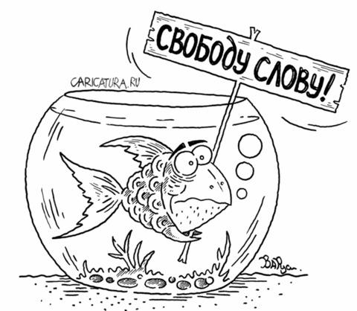
3. Information policy of the Republic of Kazakhstan, media development
The independence and sovereignty gained by the Republic of Kazakhstan served to carry out fundamental transformations in the field of mass media, which is a kind of public platform for radical changes taking place in the country.

Slide 30
The processes of market reform of the economy, democratization of the political system and public relations, and the formation of civil society create new needs for free information exchange, for obtaining prompt and multidimensional information about the state of affairs and events in all spheres of the republic's life.

Slide 31
Stages of media development in the Republic of Kazakhstan
First stage - post-Soviet, the advantage of a state monopoly on mass media (before 1992), when there were practically no independent media outlets.
Second stage – the stage of formation and growth (1992-1996), a certain departure of the state from absolute dominance in the information space and the rapid development of non-state media, a reduction in the share of state-owned media in the total number.

Slide 32
Third stage – (1997-2006) liberal, characterized by qualitative and quantitative changes in the mass media market, mass privatization of former state-owned mass media, printing enterprises, and the transition from state financing and subsidizing of mass media to state orders for the implementation of state information policy.

Slide 33
Fourth stage – (since 2007 It can be argued that the information market of Kazakhstan has entered a phase of stable growth. The state's economic support for the media played a role. Measures have been taken to increase the competitiveness of the domestic media market.

Slide 34
In Kazakhstan, over the past years, fundamental changes have been made in the field of mass media activities. The media sector was denationalized, which resulted in the fact that today more than 80% of media outlets are non-state-owned. Liberalization and market reforms have led to the quantitative and qualitative growth of the media. Today, Kazakhstan is ahead of most Central Asian and Transcaucasian countries in terms of media development.

Slide 35
Newspapers and magazines are published in 11 languages of the nations and nationalities living in the country, and TV and radio programs are broadcast. In addition to the main languages (Kazakh and Russian), the media are published in Ukrainian and Polish, in german, Korean, Uyghur, Turkish, dungan and other languages. Ethnic minority media outlets receive financial support from the Government.

Slide 36
Internet and cable TV are developing dynamically in Kazakhstan. Modern information technologies are widely used in the information market; National TV and radio stations are broadcast via the national satellite system.
In In 2002, the channel was created CaspioNet (operator EutelsatThe BBC and CNN programs are broadcast on the entire territory of the Republic via cable and satellite channels., Deutsche Welle, radio Liberty, Polish channel Polonia, Russian and other TV and radio channels.

